Slide 1
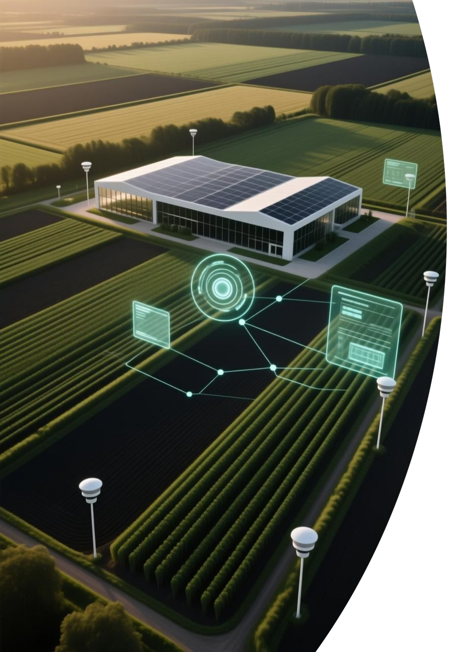
AI-Powered Digital Twin of Farmland for Predictive Farming
A comprehensive project exploring the integration of artificial intelligence, Internet of Things, and digital twin technologies to revolutionize agricultural management and enable data-driven precision farming.
Manipal University Jaipur, Department of Data Science and Engineering
Notes:
1

Slide 2
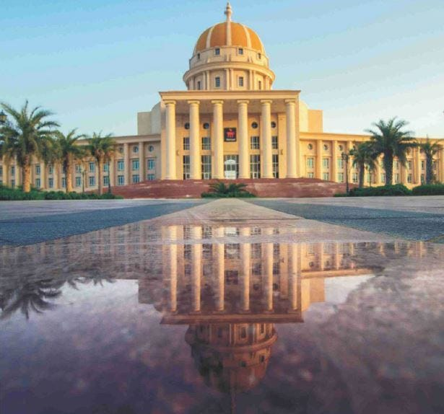
Project Team and Academic Context
Research Team
Adhiraj Singh Chauhan (2430010309)
Srijan Satyam (2430010306)
Shaurya Gupta (2430010320)
Kaustubh Negi (2430010311)
Academic Supervision
Project Guide: Dr. Ginika Mahajan, Assistant Professor
Submitted in partial fulfillment for the Bachelor of Technology degree in Computer Science and Engineering (Data Science), November 2025.
Class Instructor: Dr. Anil Kumar Prajapati, Assistant Professor
Notes:
2

Slide 3
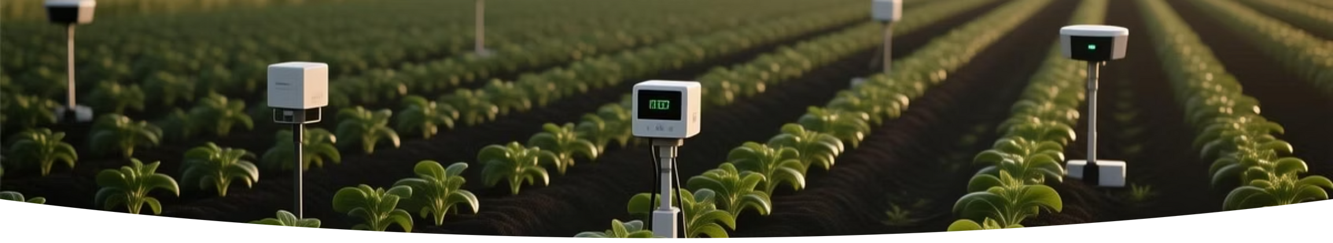

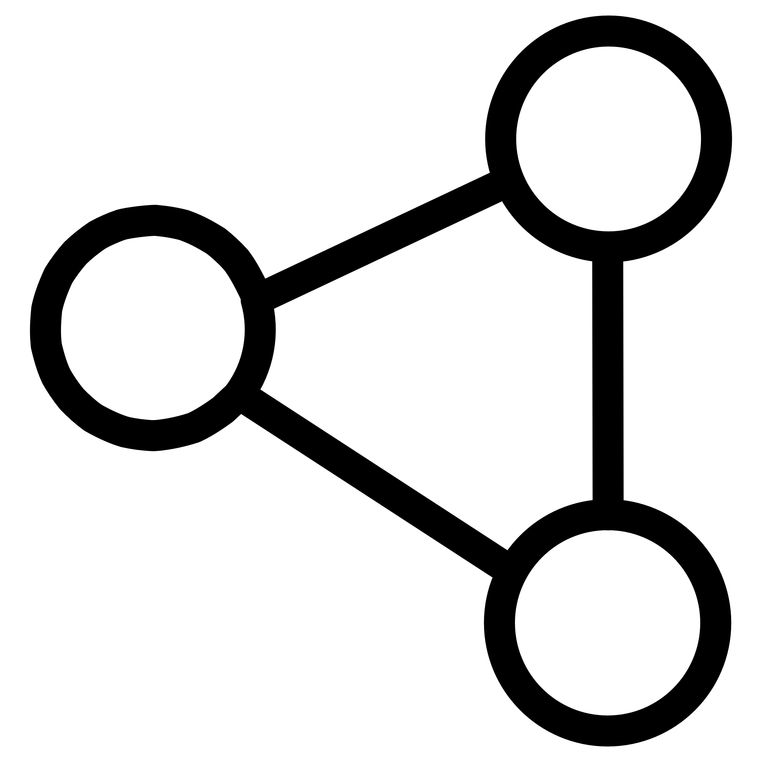

Research Foundation and Motivation
Agricultural Challenge
Technology Gap
Digital Twin Solution
Modern agriculture generates vast amounts of data from sensors, weather stations, and remote sensing, yet farmers lack integrated tools to synthesize this information for actionable insights.
Existing solutions provide fragmented data streams—soil sensors, weather apps, and drone imagery operate independently without cohesive integration or predictive capabilities.
Our system creates a dynamic virtual representation combining real-time sensor data, remote sensing imagery, and computational models for comprehensive farm visualization and prediction.
Notes:
3

Slide 4

Literature Review: State of the Art
Key Research Findings
AI-Enhanced Yield Prediction
Federated Learning Integration
AI-enabled models demonstrated 20% improvement in yield prediction accuracy, with UAVs reducing water usage by 96% and fertilizer consumption by 40%.
Privacy-preserving frameworks combine Digital Twin and IoT technologies for secure, decentralized decision-making in livestock and crop management.
Despite technological advances, the primary challenge remains integration and usability—farmers need unified systems that synthesize disparate data sources into coherent, actionable intelligence.
Notes:
4

Slide 5
Research Analysis: Methods and Limitations
Method
Application
Contribution
Limitations
Deep Learning CNNs
Plant Health
Analyzes sensor and imaging data to identify and forecast health issues
Limited temporal integration
Infrared Thermal Imaging
Water Stress
Monitors canopy temperatures and transpiration rates
Lacks multi-sensor integration
Pre-trained ResNet50
Visual Diagnosis
Efficiently processes images for nutritional deficiency detection
High computational requirements
Random Forest, SVM
Classification
Classifies plant conditions using visual cues
No holistic sensor integration
3D-3T Model
Urban Agriculture
Simplifies transpiration rate estimation
Limited to urban contexts
Our digital twin approach addresses these limitations by creating an integrated framework that combines multiple data sources and analytical techniques into a unified predictive system.
Notes:
5

Slide 6
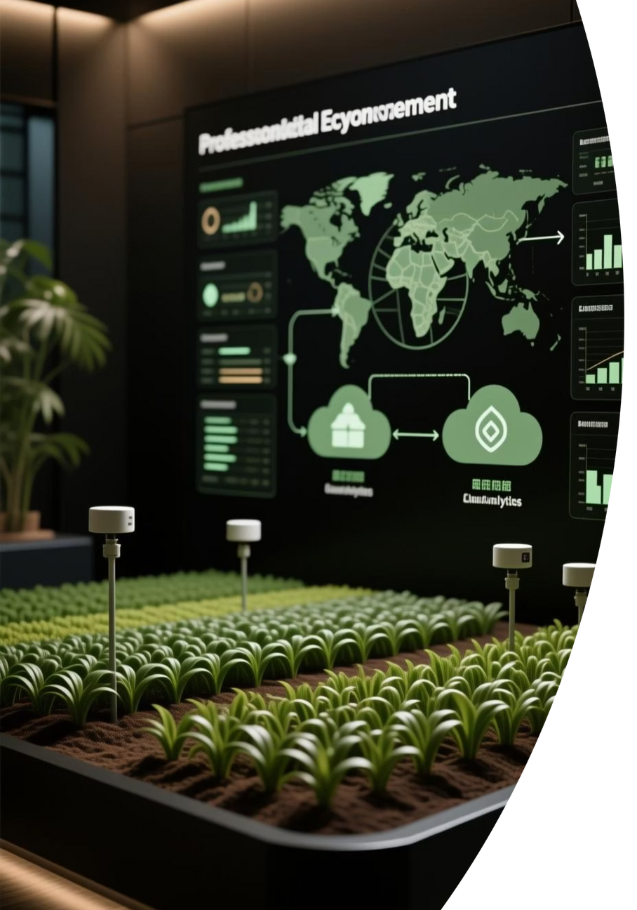
Project Objectives and Methodology
Methodology Overview
Core Objectives
Design an intelligent, interoperable system integrating AI and digital twin technologies
Data Collection: IoT seors, drones, and imaging systems continuously feed data into the digital twin model.
Enable real-time data analysis and automated environmental control
Analytics: YOLO V7, machine learning models, and AI-IoT frameworks process data to generate predictive insights.
Improve resource efficiency and prediction accuracy across agricultural operations
Output: Interactive dashboard providing real-time visualization, growth stage predictions, and optimization recommendations.
Support climate-friendly, data-driven decision making
Notes:
6

Slide 7
Expected Impact and Implementation
20%
96%
25%
40%
Yield Prediction
Water Reduction
Productivity Gain
Fertilizer Savings
Improvement in accuracy through AI-enabled models
Decreased water usage via UAV-guided precision irrigation
Enhanced crop productivity through IoT smart systems
Reduction in fertilizer consumption with targeted application
Implementation Timeline
Phase 1: Data Collection
Phase 3: Testing
Validate system performance in controlled environments
Obtain datasets and study them
1
2
3
4
Phase 2: Model Development
Phase 4: Integration
Large-scale deployment targeted for 2027
Train AI models and develop digital twin framework
Notes:
7

Slide 8
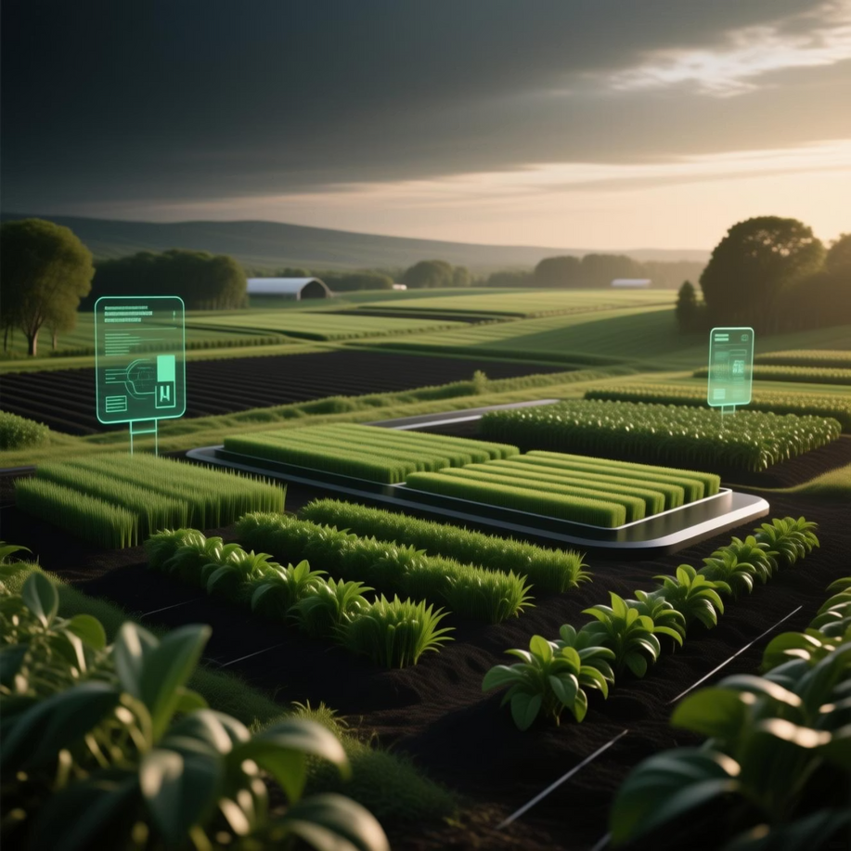
Conclusions and Future Directions
Project Summary
This research demonstrates the transformative potential of integrating AI-powered analytics, digital twins, and IoT technologies to address critical challenges in sustainable agriculture. By creating a unified, interactive system that synthesizes real-time data from multiple sources, we enable farmers to make informed decisions about irrigation, fertilization, and pest control.
Next Steps
Prioritize scalability and interoperability for diverse agricultural contexts
Enhance affordability to enable widespread farmer adoption
Expand integration with emerging precision agriculture technologies
Develop training programs for effective system utilization
"The convergence of digital twin technology with machine learning algorithms creates unprecedented opportunities for predictive farming and sustainable agricultural practices."
Notes:
8

